Slide 1

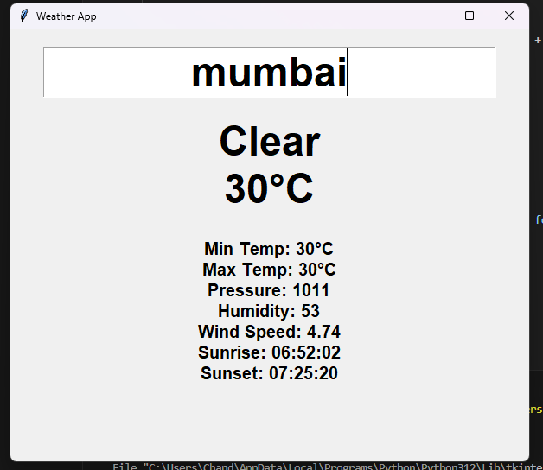
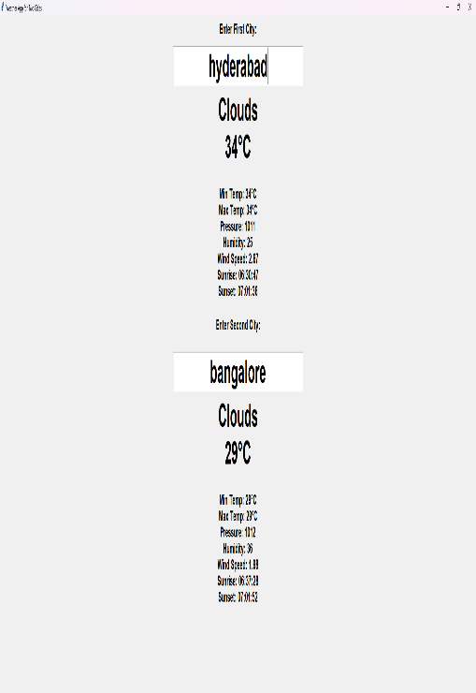
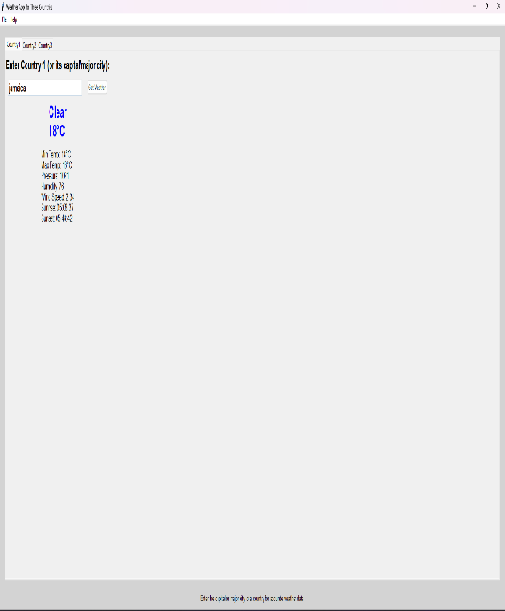
Weather forecast using ai prediction
.Creating a weather forecast system using ai involves leveraging machine learning models to predict future weather conditions based on historical data. By collecting data such as temperature, humidity ,wind speed as well . the ai model can be integrated into web app or mobile app by providing users with real-time, smart weather insights.These models analyze patterns in the data to short-term or long-term predictions.
Team Members
..Client Photo
u.chandrahas–Project lead
Ii.chaitanya-Developer
j.yashwanth–Api integration specialist
Faculty 1:Venkateshwer rao
Faculty 2:Divya siripuri
Result 1
Result 2
Result 3

